Slide 1
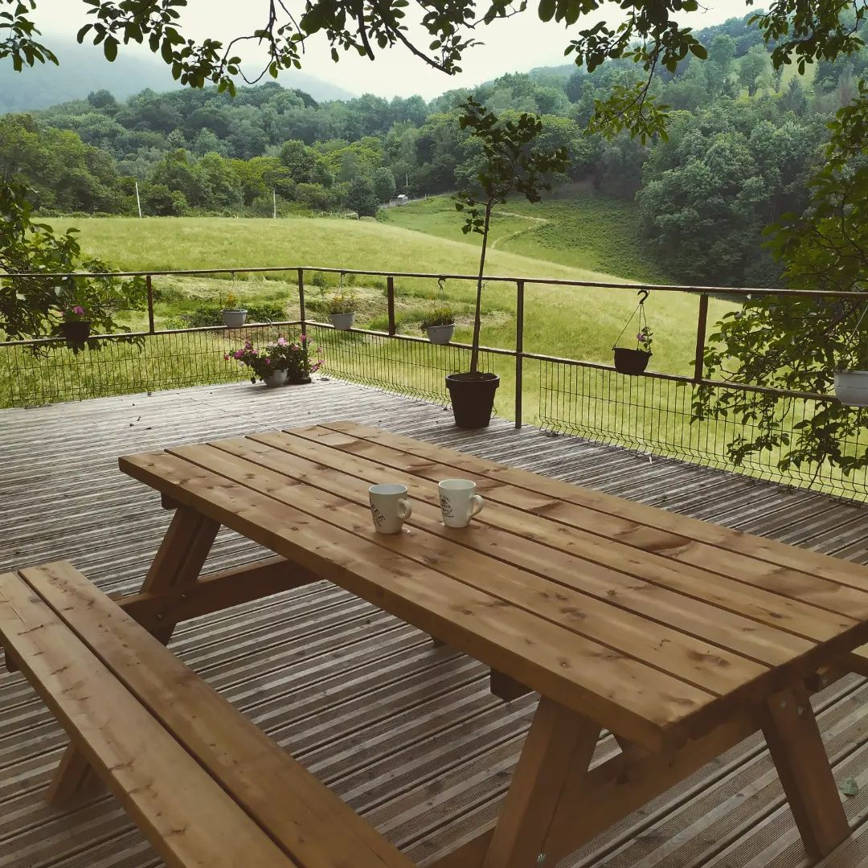
La main à la Pate

Slide 2

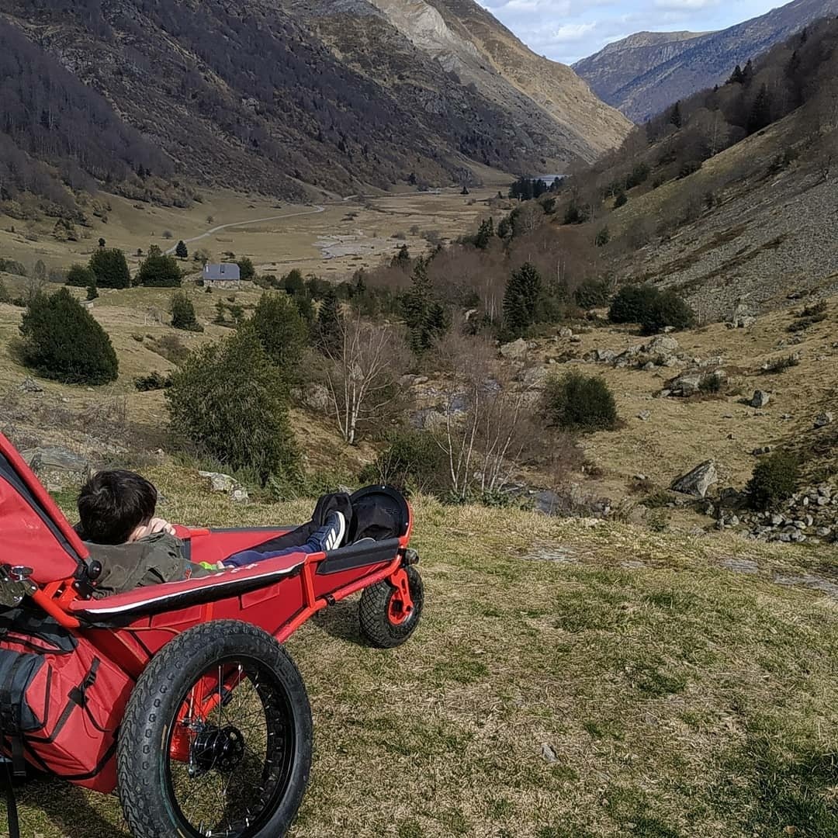
About Me
My name is Cyril
40 years old
ex electro-technician
teleworking
Family
association
Mountains
people with disabilities.

Slide 3
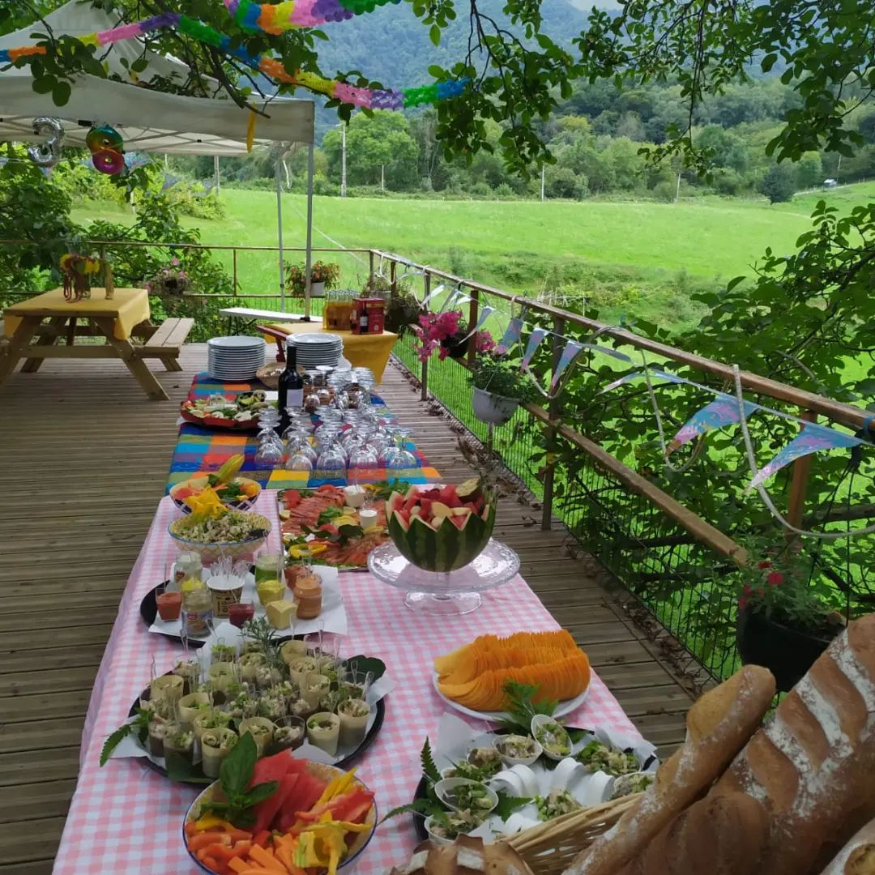

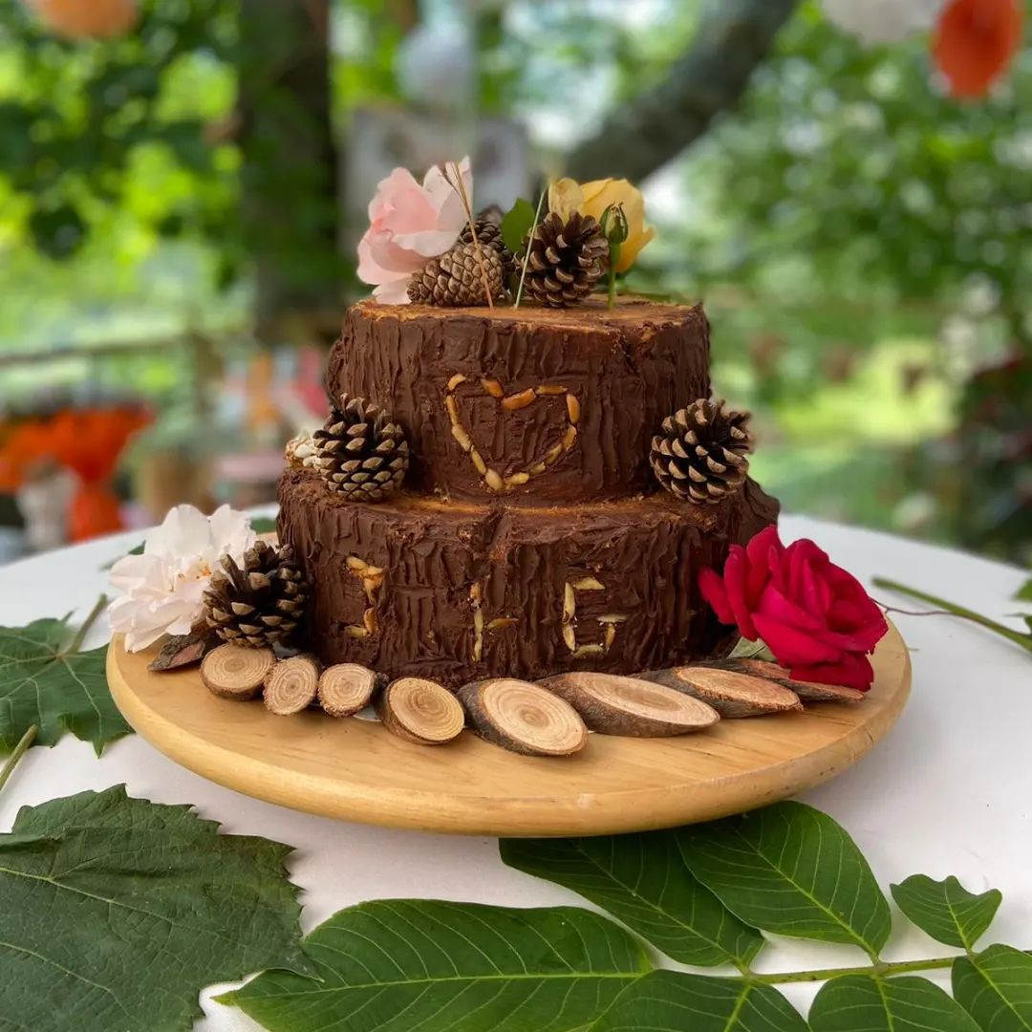
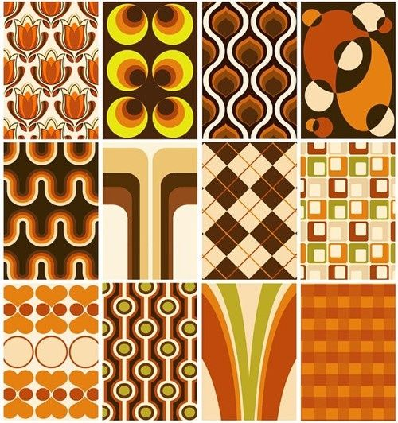

The Project
the project "La main à la Pâte"
catering and pastry-making company
discover the tastes
colours
adapt the website for visually impaired people.
discover its cuisine,
participate in
workshops
order your dishes

Slide 4
Extract

Slide 5
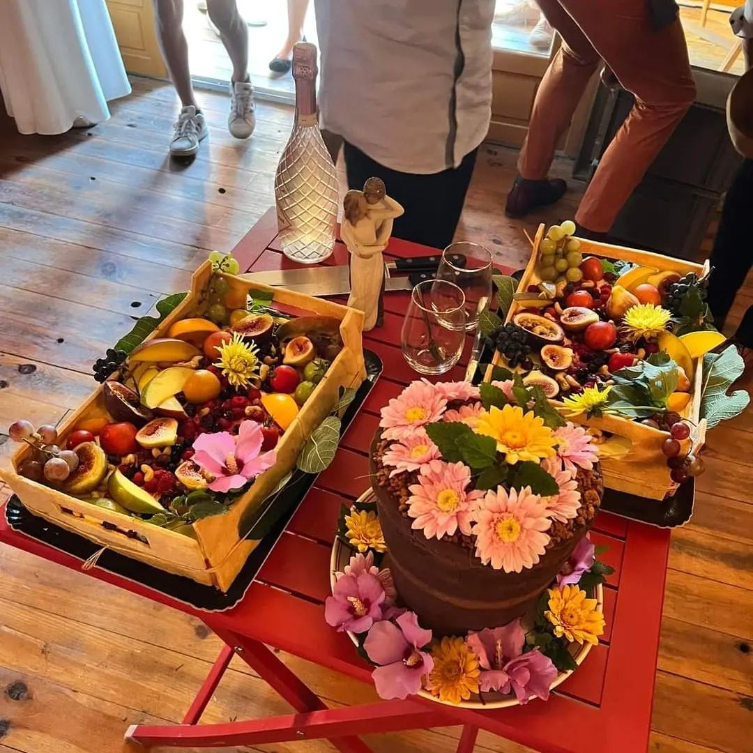
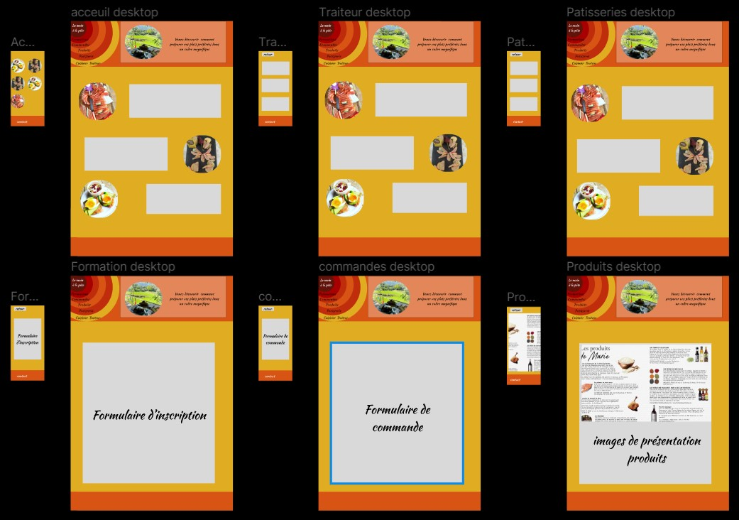
Les années 70 à l'Honneur
5

Slide 6
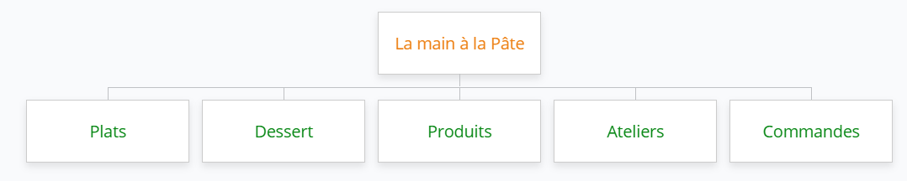
Arborescence

Slide 7
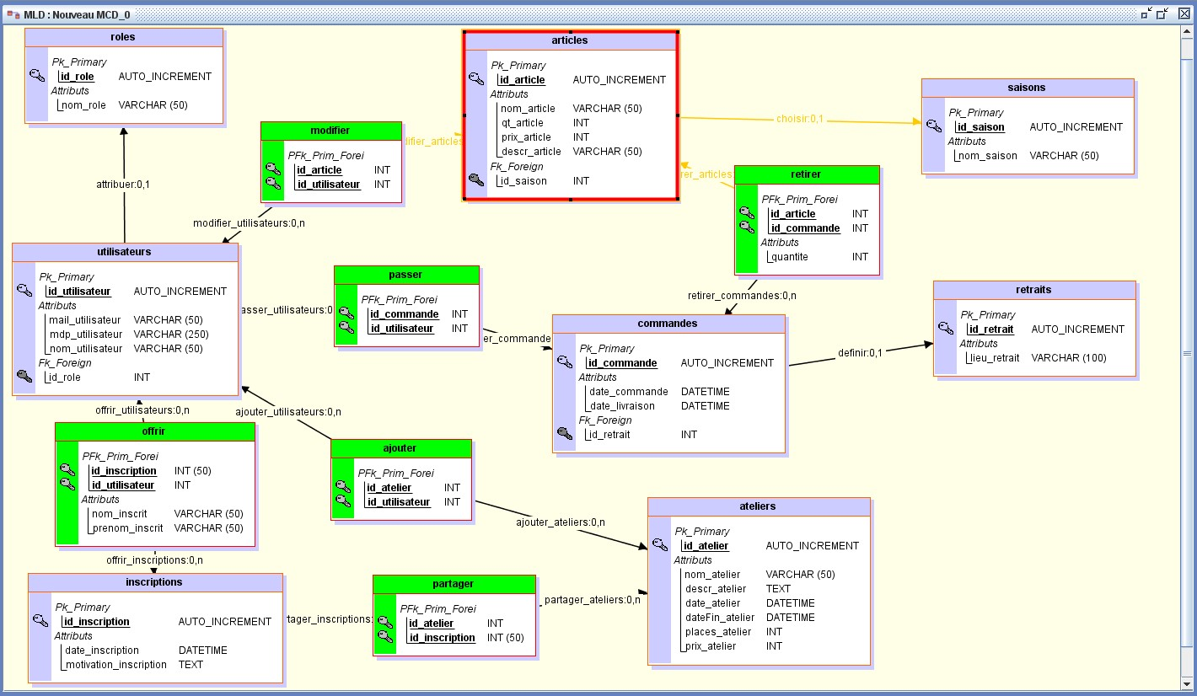
MLD
7

Slide 8
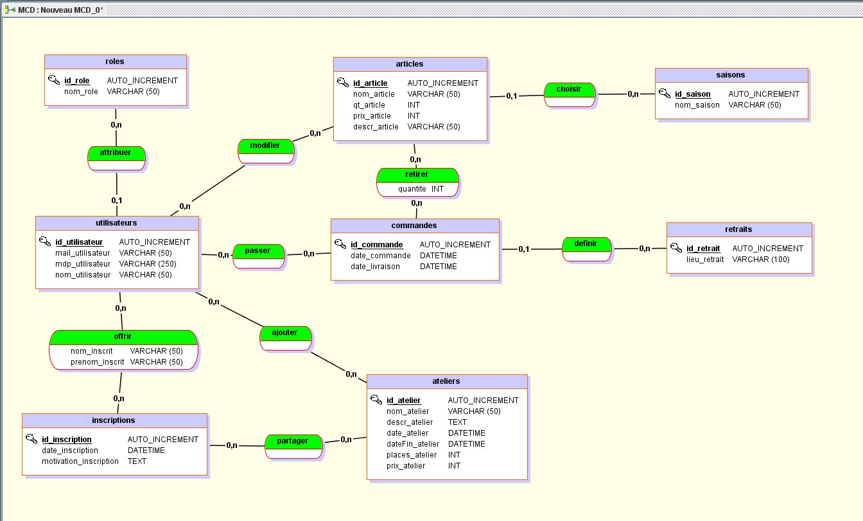
MCD
8

Slide 9
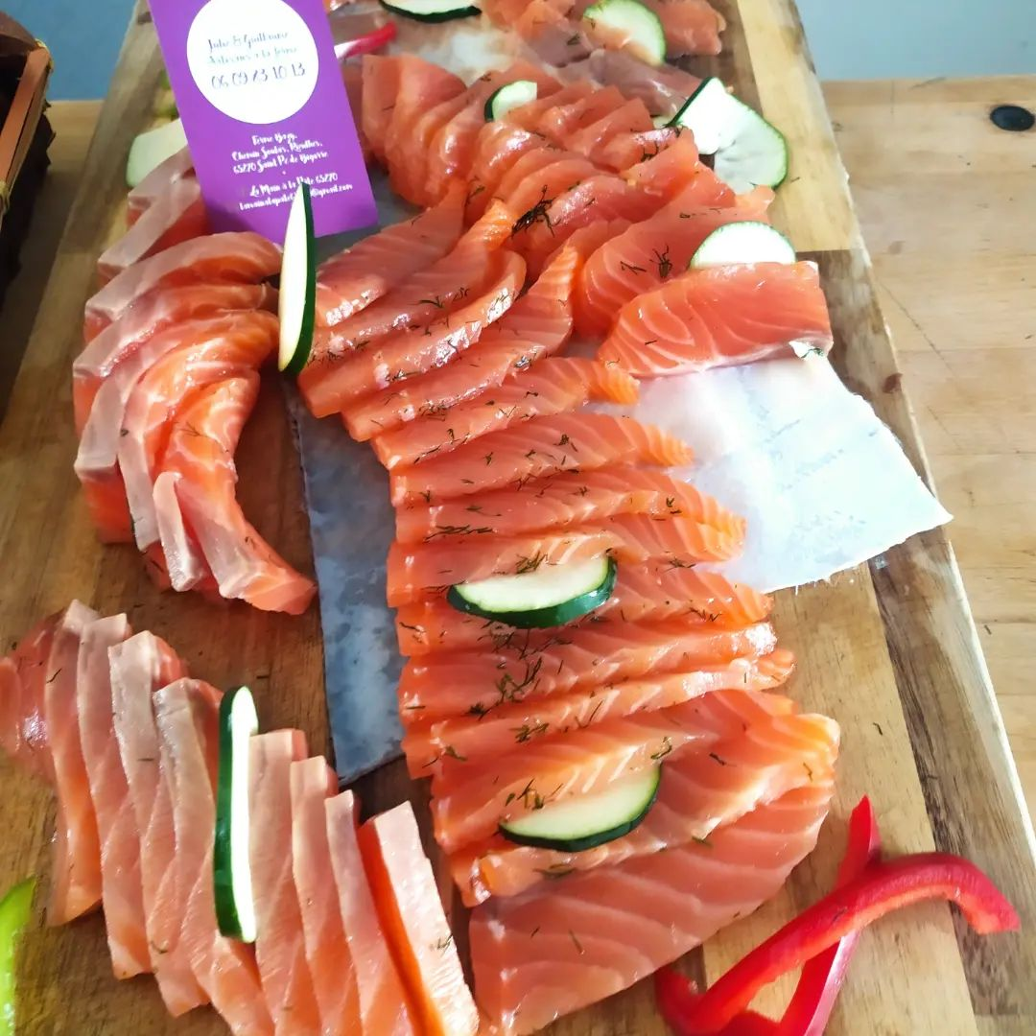
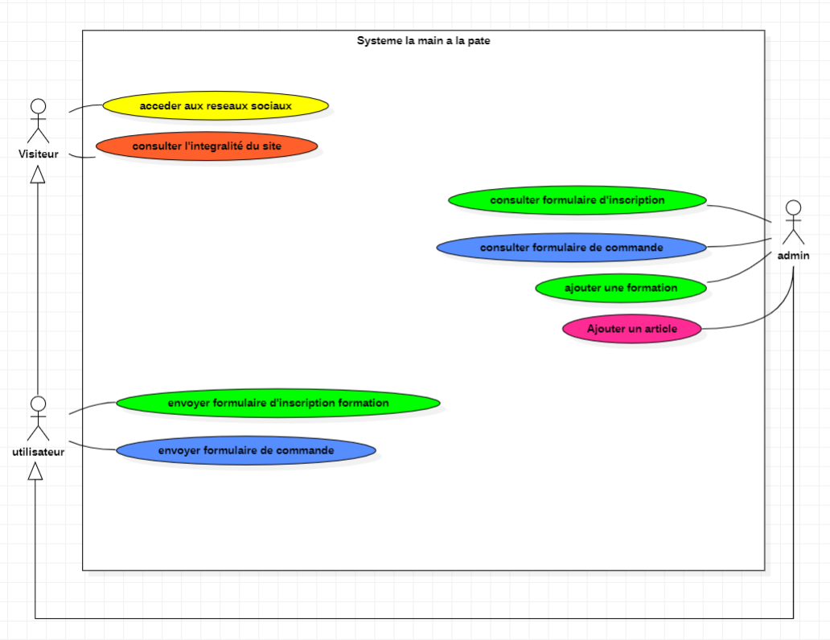
Use case
9

Slide 10
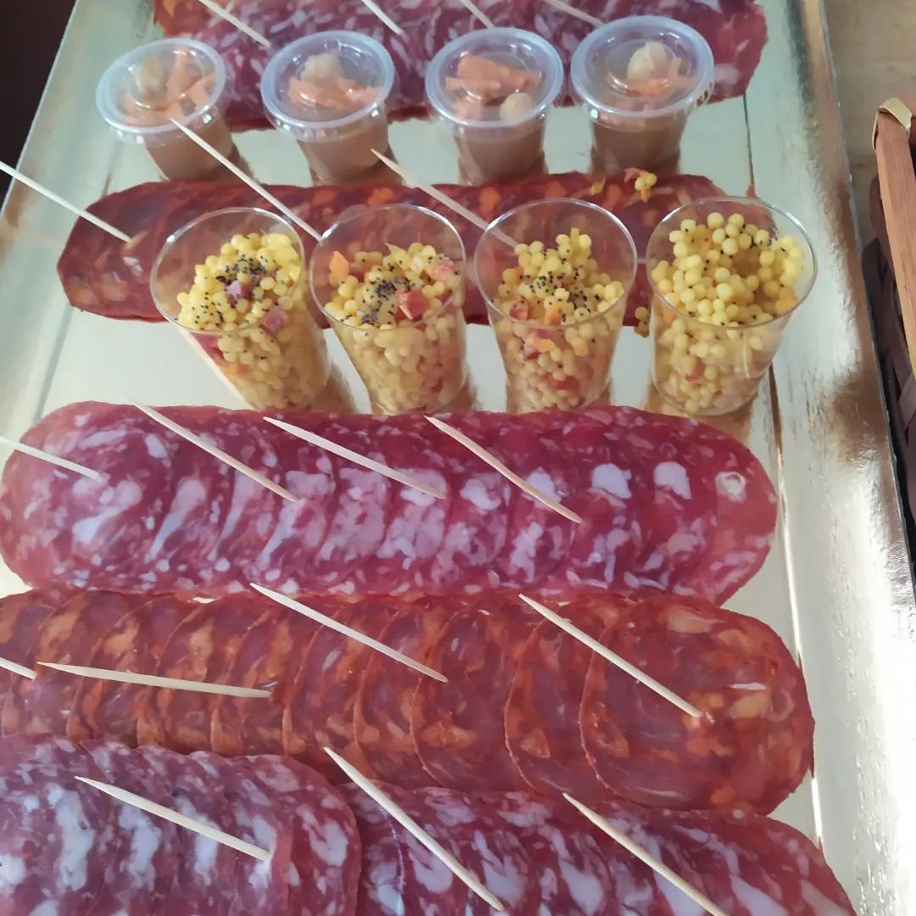
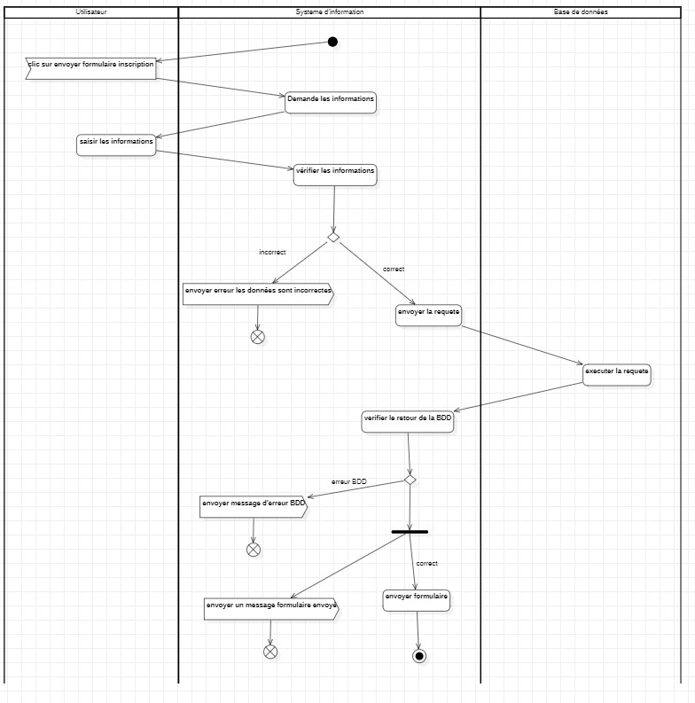
Diagramme d'activité formulaire d'inscription
10

Slide 11
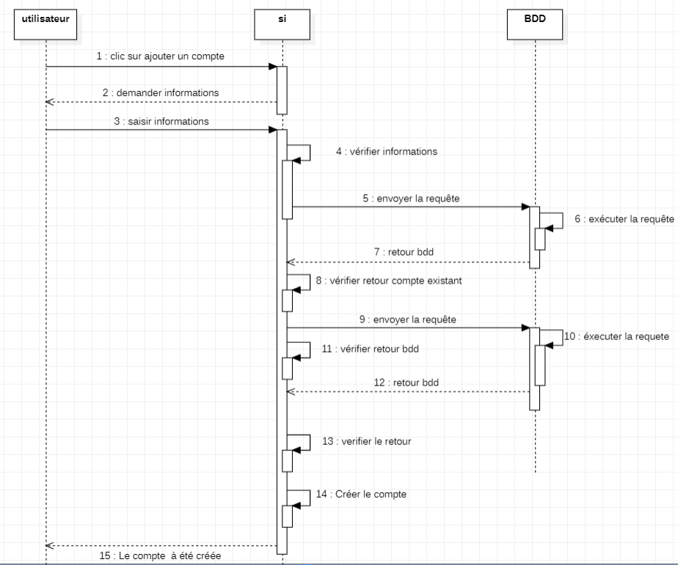
Diagramme sequentiel
11

Slide 12
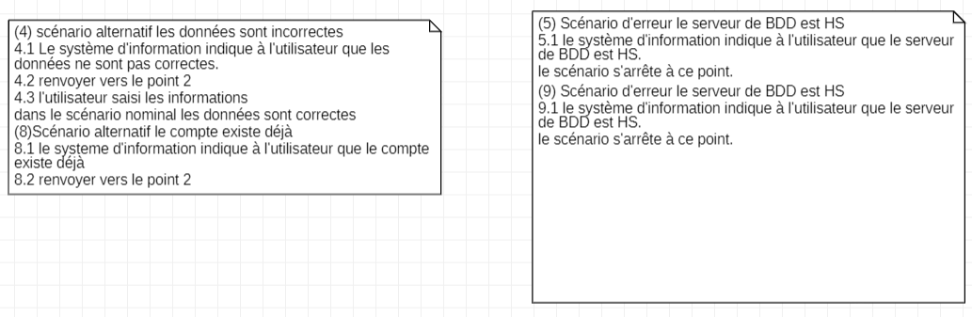
Diagramme sequentiel
12

Slide 13
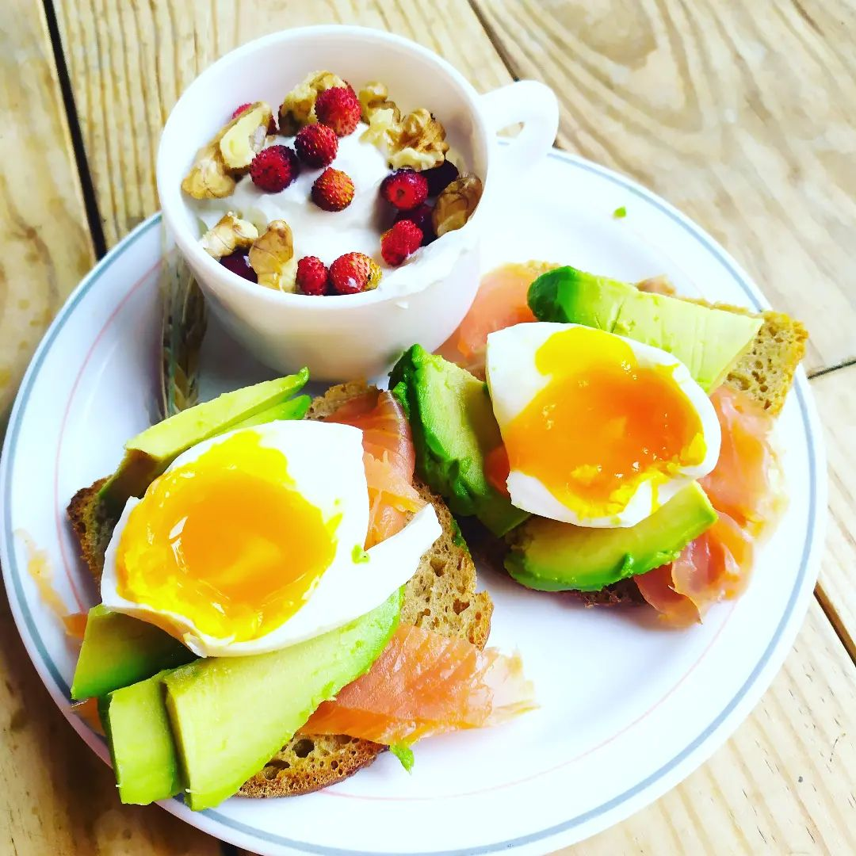

Nav bar Html Css Javascript
Le Cœur du site

Slide 14
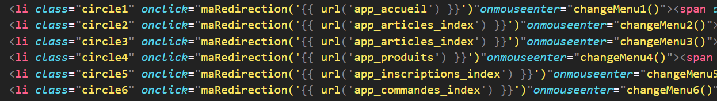
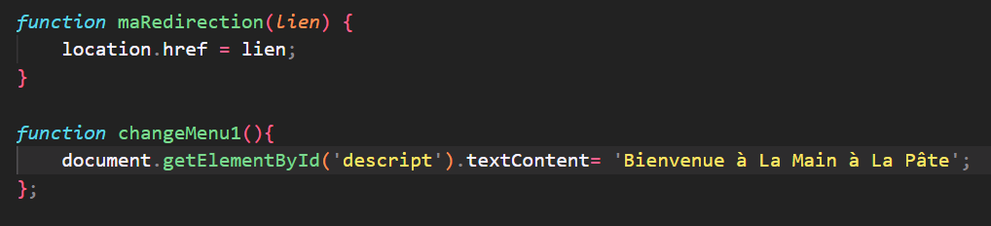
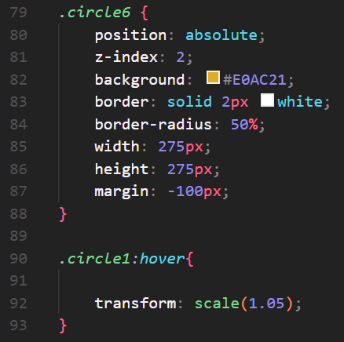
3 langages un résultat

Slide 15
Back End

